Slide 1
Operating Systems
Chapter 2 Operating System Overview

Slide 2
Agenda
2.1 Operating System Objectives and Functions
2.2 The Evolution of Operating Systems
2.3 Major Achievements
2.4 Developments Leading to Modern Operating Systems

Slide 3
2.1 Operating System Objectives and Functions
2.1.0 Introduction
2.1.1 The Operating System as a User/Computer Interface
2.1.2 The Operating System as Resource Manager
2.1.3 Ease of Evolution of an Operating System
Notes:
Ease of Evolution
易演化

Slide 4
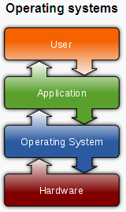
2.1.0 Introduction (1/2)
operating System definition: A program that
  controls the execution of application programs
  Acts as an interface between applications and hardware

Slide 5
2.1.0 Introduction (2/2)
Operating System Objectives
  As User/Computer Interface --Convenience/方便
    Makes the computer more convenient to use
  As Resource Manager--Efficiency /有效
    Allows computer system resources to be used in an efficient manner
  As System Software--Ability to evolve /扩展
    Permit effective development, testing, and introduction of new system functions without interfering with service
Notes:
Convenience—one of key features of Apple series OS 苹果系列
Efficiency—MIUI Benchmark 指出FDDB是由马萨诸塞大学计算机系维护的全世界最具权威的人脸检测评测平台，并恭喜小米研发人员取得全球第一成
Ability of evolve—iOS jailbreak OS越狱(英文: iOS Jailbreaking), 是对于苹果公司系列设备（iPhone、iPod、iPad、Apple TV）的操作系统“iOS”进行破解的一种技术手段, 用户使用这种技术及软件可以获取到iOS的最高权限,甚至可以进一步解开运营商对手机网络的限制. 越狱软件适用于iPhone, iPod touch, iPad 及 Apple TV上的iOS系统
2015年6月5日，MIUI发布了一个新功能——面孔相册。小米云相册利用图像分析技术，可以自动地对云相册照片内容按照面孔进行分类整理。
interfering with service干扰服务

Slide 6
2.1 Operating System Objectives and Functions
2.1.0 Introduction
2.1.1 The Operating System as a User/Computer Interface
2.1.2 The Operating System as Resource Manager
2.1.3 Ease of Evolution of an Operating System

Slide 7
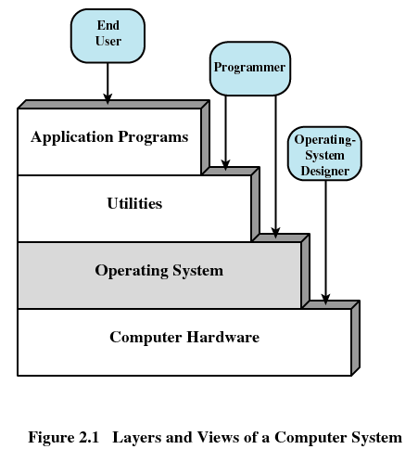
2.1.1 The Operating System as a User/Computer Interface
Layers of Computer System

Slide 8
2.1 Operating System Objectives and Functions
2.1.0 Introduction
2.1.1 The Operating System as a User/Computer Interface
2.1.2 The Operating System as Resource Manager
2.1.3 Ease of Evolution of an Operating System

Slide 9
2.1.2 The Operating System as Resource Manager (1/3)
The Operating System as Resource Manager
  Responsible for managing resources/Hardware
  Work in the same way as ordinary computer software
    It is program that is executed
  Operating system frequently relinquishes(放弃) and regains control of the processor
Notes:
ordinary 普通的

Slide 10
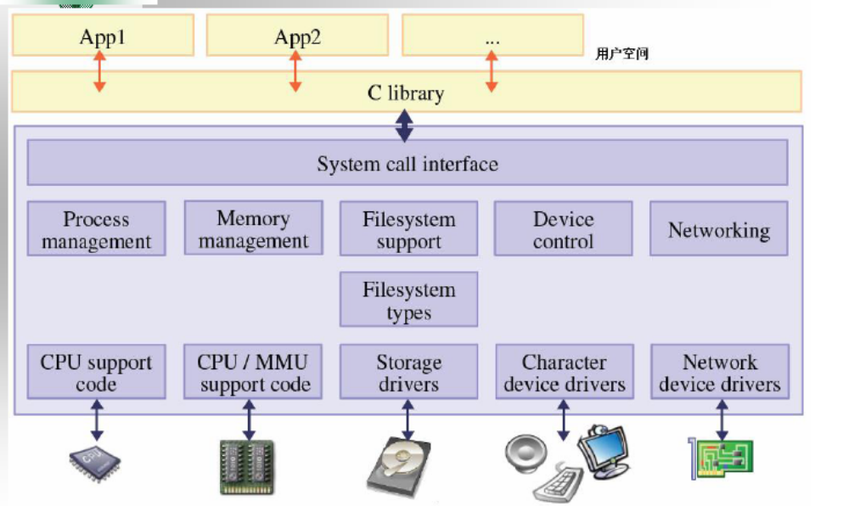
2.1.2 The Operating System as Resource Manager (2/3)
Notes:
操作系统控制应用程序访问底层软件和硬件；控制和访问文件
MMU是Memory Management Unit的缩写，中文名是内存管理单元

Slide 11
2.1.2 The Operating System as Resource Manager (3/3)
Kernel(内核)
  Portion of operating system that is in main memory
  Contains most frequently used functions
  Also called the nucleus（核子）

Slide 12
2.1 Operating System Objectives and Functions
2.1.0 Introduction
2.1.1 The Operating System as a User/Computer Interface
2.1.2 The Operating System as Resource Manager
2.1.3 Ease of Evolution of an Operating System

Slide 13
2.1.3 Ease of Evolution of an Operating System (1/1)
Why ?
  Hardware upgrades plus new types of hardware
  New services
  Fixes Bug
How ?
  Modularization
  OS Architecture [for more detail later on 2.3.5 ]
Notes:
USB的支持3.0
ISCSI服务
模块化 Modularization

Slide 14
Agenda
2.1 Operating System Objectives and Functions
2.2 The Evolution of Operating Systems
2.3 Major Achievements
2.4 Developments Leading to Modern Operating Systems

Slide 15
2.2 The Evolution of Operating Systems
2.2.1 Serial Processing: No Operating Systems
2.2.2 Simple Batch Systems
2.2.3 Multiprogrammed Batch Systems
2.2.4 Time-Sharing Systems
Notes:
串行处理系统：无操作系统概念,用户串行使用系统，系统串行执行任务。
之后为了方便无人值守的批量任务执行，产生了单任务的批处理操作系统，批处理操作系统的任务很简单，按照实现设定好的顺序把任务装入执行。
为了提高CPU的利用率，出现了多道批处理系统。
为了充分利用大型机等昂贵设备的资源，产生了多任务操作系统（分时操作系统），为了让一般的学生和科学工作者也可以分享大型机的计算能力，出现了大型机+分时操作系统+ 哑终端的模式。
之后，慢慢出现了为普通人服务的微型机，也就是个人电脑。然而最早的个人电脑也是没有操作系统的，最早的个人电脑是阿尔塔（牛郎星电脑）没有键盘，显示器，只有开关和灯泡（像不像微型版的ENIAC）。微软第一个成功的商业产品其实就是给牛郎星写的BASIC解释器，因为很多人免费使用（也就是盗版）这个BASIC解释器，比尔盖茨写了封“给爱好者们的公开信”，成为商业软件产业诞生的标志。实际上我们知道的著名的Apple I上面也并没有安装操作系统，只有一个ROM BASIC和引导程序。
From: <什么是操作系统？兼谈WebOS >: http://tech.163.com/06/0520/14/2HIT72KQ00091JUR.html

Slide 16
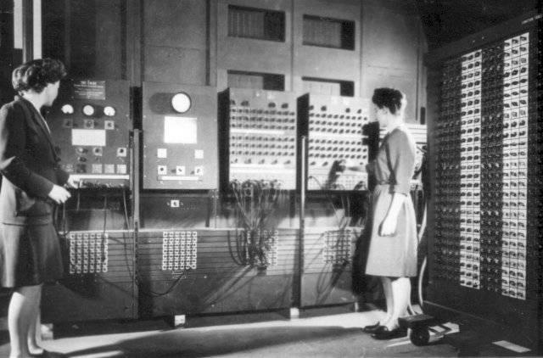
2.2.1 Serial Processing(1/2)
操作ENIAC
Time
  1940s-1950s
Notes:
最早的ENIAC 电子数字积分计算机; （Electronic Numerical Integrator and Computer）没有键盘显示器等等的，所有的输入操作都是通过对开关的通断来实现的，输出是通过灯泡的亮灭显示的，改变计算公式甚至需要对线路进行重新的布置，那个年代是没有操作系统的
ENIAC里面并没有内存，只有寄存器，而且控制系统是通过硬接线实现的，想改变公式就需要对线路重新布置。这样操作其实非常的不方便。
所以，著名的“计算机之父”冯·诺依曼加入这个计划之后，提出了改进意见EDVAC （Electronic Discrete Variable Automatic Computer）计划。EDVAC实际上就是最早的冯诺依曼结构的雏形，现在我们使用的通用计算机结构仍旧属于冯诺依曼结构。
From: <什么是操作系统？兼谈WebOS >: http://tech.163.com/06/0520/14/2HIT72KQ00091JUR.html

Slide 17
2.2.1 Serial Processing(2/2)
命名起源：the user have access to the system in series
特点：the programmer interacted directly with the computer hardware
如何操作：Machines run from a console with display lights, toggle switches, input device, and printer
Problem
  Scheduling: Most installations装置 used a hardcopy sign-up sheet to reserve computer time
  Setup准备time: included loading the compiler, source program, saving compiled program, and loading and linking
Notes:
串行处理
对于早期的计算机，从20世纪40年代后期到20世纪50年代中期，程序员都是直接与计算
机硬件打交道的，因为当时还没有操作系统。这些机器都是在一个控制台上运行的，控制台包括
显示灯、触发器（钮子开关; 拨动开关; 摇杆开关;）、某种类型的输人设备和打印机。用机器代码编写的程序通过输人设备(如卡片
阅读机)载人计算机。如果一个错误使得程序停止，错误原因由显示灯指示。如果程序正常完成，
输出结果将出现在打印机中。
调度:大多数装置都使用一个硬拷贝的登记表预订机器时间。通常，一个用户可以以半
小时为单位登记一段时间。有可能用户登记了1小时，而只用了45分钟就完成了工作，
在剩下的时间中计算机只能闲置，这时就会导致浪费。另一方面，如果用户遇到一个问
题，没有在分配的时间内完成工作，在解决这个间题之前就会被强制停止。
.准备时间:一个程序称做作业，它可能包括往内存中加载编译器和高级语言程序(源程
序)，保存编译好的程序(目标程序)，然后加载目标程序和公用函数并链接在一起。每
一步都可能包括安装或拆卸磁带，或者准备卡片组。如果在此期间发生了错误，用户只
能全部重新开始。因此，在程序运行前的准备需要花费大量的时间。

Slide 18
2.2 The Evolution of Operating Systems
2.2.1 Serial Processing : No Operating Systems
2.2.2 Simple Batch Systems
2.2.3 Multiprogrammed Batch Systems
2.2.4 Time-Sharing Systems

Slide 19
2.2.2 Simple Batch Systems (1/7)
The central idea behind the simple batch processing scheme is
  Batch: made up by many jobs from users
    A job may use several program
  the use of a piece of software known as the monitor that controls the sequence of events.

Slide 20
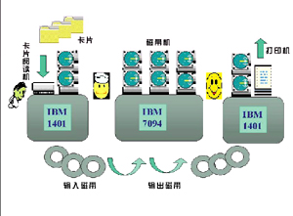
2.2.2 Simple Batch Systems (2/7)
举例：IBM 7094 简单/单任务批处理系统
  Batch / 批: 多个用户作业
Monitor

Slide 21
2.2.2 Simple Batch Systems (3/7)
The Process
  The monitor reads a job from the batch
  Then control is passed to this job
  When the job is completed, it returns control to the monitor
  The monitor reads in the next job

Slide 22
2.2.2 Simple Batch Systems (4/7)
Job Control Language (JCL)
  Special type of programming language
  Provides instruction to the monitor
    What compiler to use
    What data to use
    …….

Slide 23
2.2.2 Simple Batch Systems (5/7)
Hardware Features
  Memory protection
    Do not allow the memory area containing the monitor to be altered
  Timer
    Prevents a job from monopolizing独占 the system
Notes:
monopolizing 独占; 垄断( monopolize的现在分词 ); 专卖; 专营;

Slide 24
2.2.2 Simple Batch Systems (6/7)
Hardware Features(cont.)
  Privileged instructions
    Certain machine level instructions can only be executed by the monitor
  Interrupts
    This feature gives the OS more flexibility in relinquishing control to and regaining control from user programs
Notes:
Relinquishing 放弃

Slide 25
2.2.2 Simple Batch Systems (7/7)
CPU mode
  User program executes in user mode(用户模式)
    Certain instructions may not be executed
    Some memory can not be accessed
  Monitor executes in system mode(系统模式)
    Kernel mode(内核模式)
    Privileged instructions are executed
    Protected areas of memory may be accessed
Notes:
Privileged instructions 特权指令

Slide 26
2.2 The Evolution of Operating Systems
2.2.1 Serial Processing : No Operating Systems
2.2.2 Simple Batch Systems
2.2.3 Multiprogrammed Batch Systems
2.2.4 Time-Sharing Systems

Slide 27
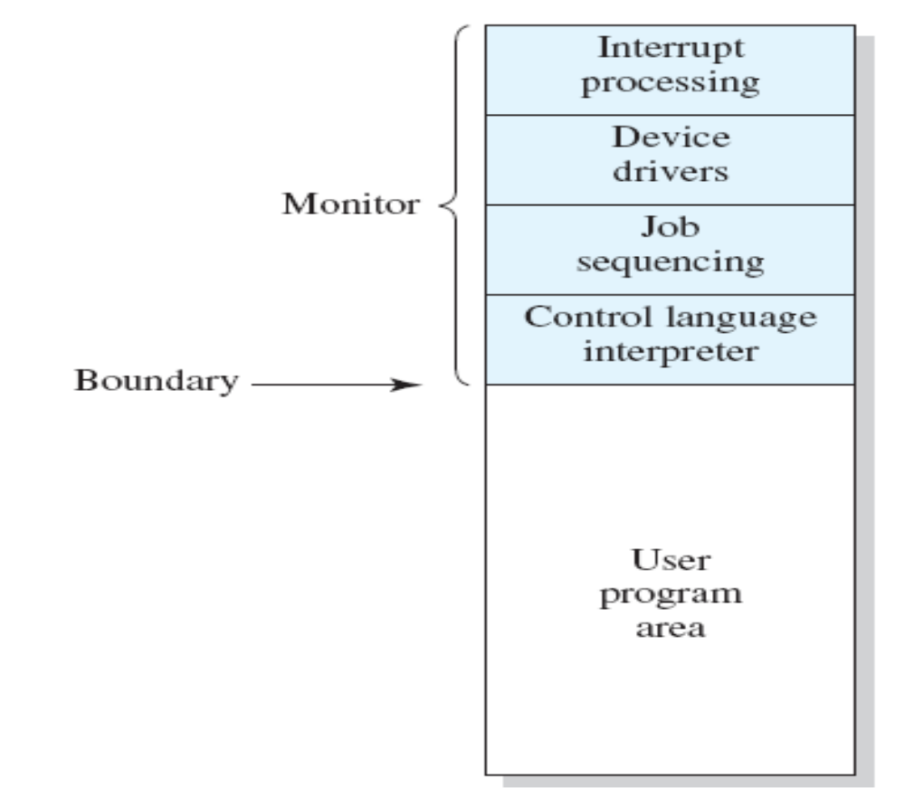
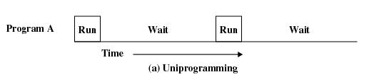
2.2.3 Multiprogrammed Batch Systems (1/6)
Simple Batch Systems
  Only one job in memory at a time
Notes:
Uniprogram单道程序

Slide 28
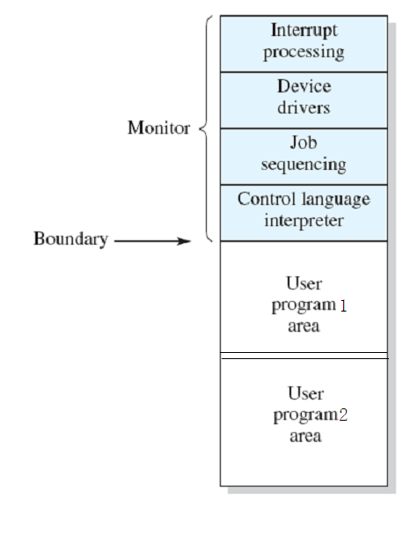
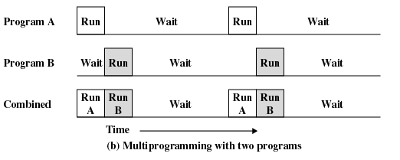
2.2.3 Multiprogrammed Batch Systems (2/6)
Multiprogrammed Batch Systems
  Multiple jobs in memory at a time
Why ?
  I/O Devices Slow
    CPU not Busy

Slide 29
2.2.3 Multiprogrammed Batch Systems (3/6)
Uniprogramming(单道程序设计)
  Processor must wait for I/O instruction to complete before preceding
Multiprogramming(多道程序设计)
  When one job needs to wait for I/O, the processor can switch to the other job
  Also known as Multitasking(多任务处理)

Slide 30
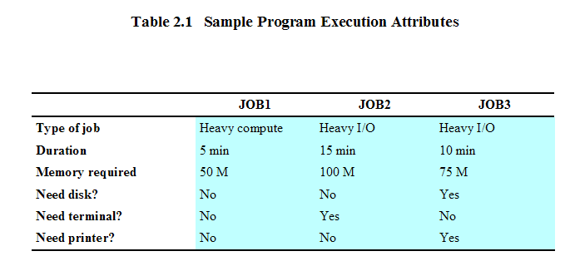
2.2.3 Multiprogrammed Batch Systems (4/6)
Example: 3个作业/程序
  各自情况描述
Notes:
Duration 持续，持续的时间，期间;

Slide 31
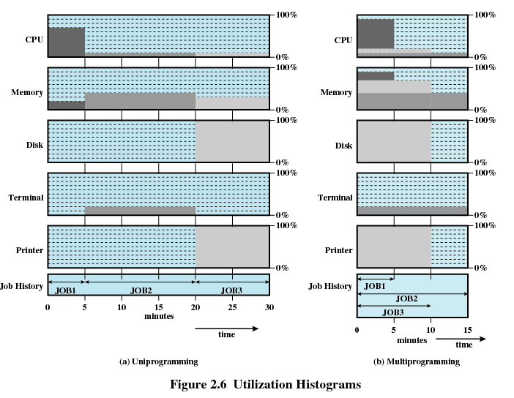
2.2.3 Multiprogrammed Batch Systems (5/6)
Example: 3个作业/程序 (cont.)
  Utilization Histograms(利用率直方图)
Notes:
利用率计算方法，如CPU
单道程序： (0.7*5+0.1*25)/30 = 0.2
多道程序：(0.9 *5 + 0.2 *5 + 0.1*5)/15 = 0.4
响应时间计算方法：
从提交到计算完毕所需要的时间，本例中，假设3个JOB在开始时同时提交。

Slide 32
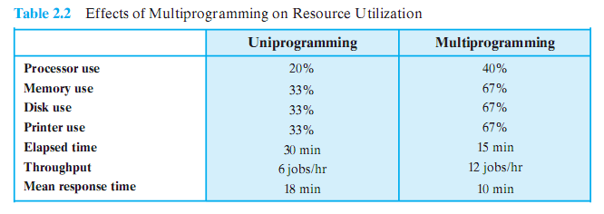
2.2.3 Multiprogrammed Batch Systems (6/6)
Example: 3个作业/程序(cont.)
  Effects of Multiprogramming on Resource Utilization

Slide 33
2.2 The Evolution of Operating Systems
2.2.1 Serial Processing : No Operating Systems
2.2.2 Simple Batch Systems
2.2.3 Multiprogrammed Batch Systems
2.2.4 Time-Sharing Systems

Slide 34
2.2.4 Time-Sharing Systems (1/2)
Why?
  Background: 1960s
    Mainframe Computer主计算机 System:
    Multiple users simultaneously access the system through terminals
  Requirement: handle multiple interactive users/jobs
Idea
  Processor’s time is shared among multiple users/jobs
Notes:
mainframe computer system
主计算机系统;

Slide 35
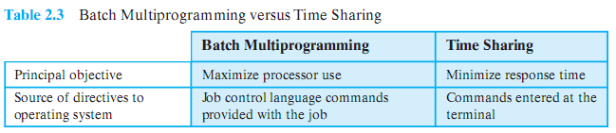
2.2.4 Time-Sharing Systems (2/2)
Batch Multiprogramming VS Time Sharing
Notes:
操作系统指令源

Slide 36
Agenda
2.1 Operating System Objectives and Functions
2.2 The Evolution of Operating Systems
2.3 Major Achievements
2.4 Developments Leading to Modern Operating Systems

Slide 37
2.3 Major Achievements
2.3.1 The Process
2.3.2 Memory Management
2.3.3 Information Protection and Security
2.3.4 Scheduling and Resource Management
2.3.5 System Structure

Slide 38
2.3.1 The Processes (1/2)
Processes consists of three components
  An executable program /code
  Associated data needed by the program
  Execution context of the program (the core)
    All information the operating system needs to manage the process
The process is realized/implemented as a data structure
  All information the operating system needs to manage the process is stored in the data structure

Slide 39
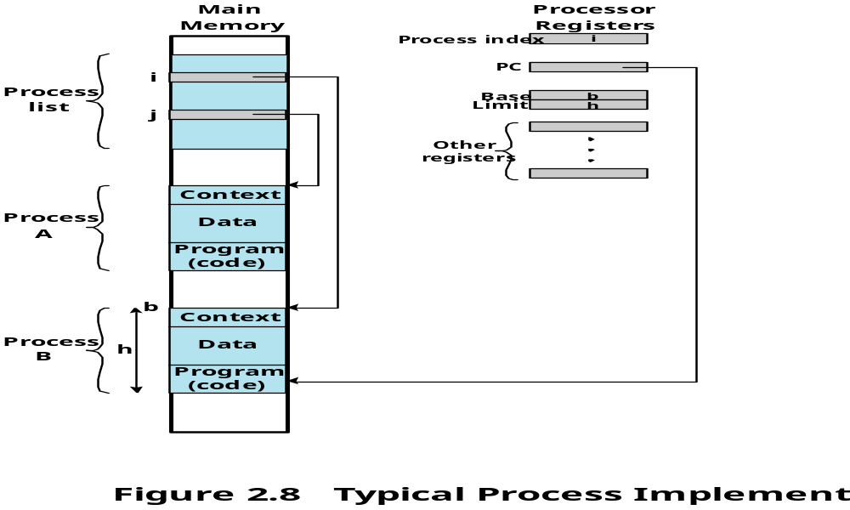
2.3.1 The Processes (2/2)
An example
CPU
Notes:
基址、界址

Slide 40
2.3 Major Achievements
2.3.0 Introduction
2.3.1 The Process
2.3.2 Memory Management
2.3.3 Information Protection and Security
2.3.4 Scheduling and Resource Management
2.3.5 System Structure

Slide 41
2.3.2 Memory Management (1/3)
OS has five storage management responsibilities:
  Process isolation(进程隔离)
  Automatic allocation and management(自动分配和管理)
  Support of modular programming(模块化程序设计)
  Protection and access control (保护与存取控制)
  Long-term storage(长期存储)
Notes:
Long-term storage(长期存储)；文件管理系统；

Slide 42
2.3.2 Memory Management (2/3)
Virtual Memory / VM
  Allows programmers to address memory from a logical point of view
  No hiatus(脱节) between the execution of successive processes while one process was written out to secondary store and the successor process was read in
Page
  Allows process to be comprised of a number of fixed-size blocks, called pages
  Each page may be located any where in main memory
Notes:
successive 连续

Slide 43
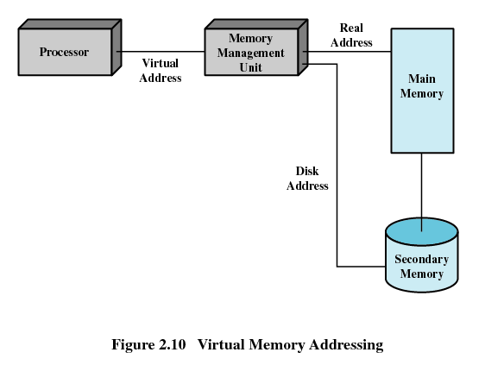
2.3.2 Memory Management (3/3)
Virtual Memory Addressing
  Storage system consists of main memory and auxiliary memory

Slide 44
2.3 Major Achievements
2.3.0 Introduction
2.3.1 The Process
2.3.2 Memory Management
2.3.3 Information Protection and Security
2.3.4 Scheduling and Resource Management
2.3.5 System Structure

Slide 45
2.3.3 Information Protection and Security(1/1)
Availability可用性
Confidentiality保密性
Data integrity数据完整性
Authenticity授权性
Notes:
Availability – 12306网站
Confidentiality – Feb 24,2014, University of Waterloo, student application system
Confidentiality 保密性
Data integrity 数据完整性

Slide 46
2.3 Major Achievements
2.3.0 Introduction
2.3.1 The Process
2.3.2 Memory Management
2.3.3 Information Protection and Security
2.3.4 Scheduling and Resource Management
2.3.5 System Structure

Slide 47
2.3.4 Scheduling and Resource Management (1/2)
Manage the resources (such as CPU, Main Memory, I/O devices)
Schedule/调度 these resources to various active processes/进程

Slide 48
2.3.4 Scheduling and Resource Management (2/2)
The factors that should be considered
  Fairness(公平性)
    Give equal and fair access to resources
  Differential responsiveness(有差别的响应性)
    Discriminate among different classes of processes
  Efficiency(高效性)
    Maximize throughput(吞吐量), minimize response time(响应时间), and accommodate as many users as possible

Slide 49
2.3 Major Achievements
2.3.0 Introduction
2.3.1 The Process
2.3.2 Memory Management
2.3.3 Information Protection and Security
2.3.4 Scheduling and Resource Management
2.3.5 System Structure

Slide 50
2.3.5 System Structure (1/4)
The size and complexity of operating systems has grown.
  CTSS: 32,000 36-bit words
  OS/360: more than a million machine instructions
  Multics: more than 20 million instructions.
  Windows
    Windows NT 4.0: 16 million lines of code
    Windows 2000: more than 32 million lines of code
    Windows XP: 35 million lines of code
    Windows Vista: 50 million lines of code
  Linux 2.6.27: 10 million lines of code

Slide 51
2.3.5 System Structure (2/4)
Led to four unfortunate but all-too-common problems
  chronically late习惯性落后in being delivered
  performance is often not what was expected
  have latent bugs
  it has proved impossible to deploy a complex OS that is not vulnerable不易to a variety of security attacks
Solution：
  The software must be modular and modules must have well-defined interfaces
  Levels
Notes:
一个功能完善的操作系统的大小和它所处理的任务的困难性，导致了4个让人遗憾但又普遍
存在的问题。第一，操作系统在交付使用时就习惯性地表现出落后，这就要求有新的操作系统或
升级老的系统。第二，随着时间的推移会发现越来越多潜在的缺陷，这些缺陷必须及时修复。第
三，总是难以达到期望的性能。第四，理论表明，不可能开发出既复杂的又不易受各种包括病毒。 Vulnerable不易

Slide 52
2.3.5 System Structure (3/4)
View the system as a series of levels
  Each level performs a related subset of functions
  Each level relies on the next lower level to perform more primitive functions
  效果：This decomposes a problem into a number of more manageable subproblems

Slide 53
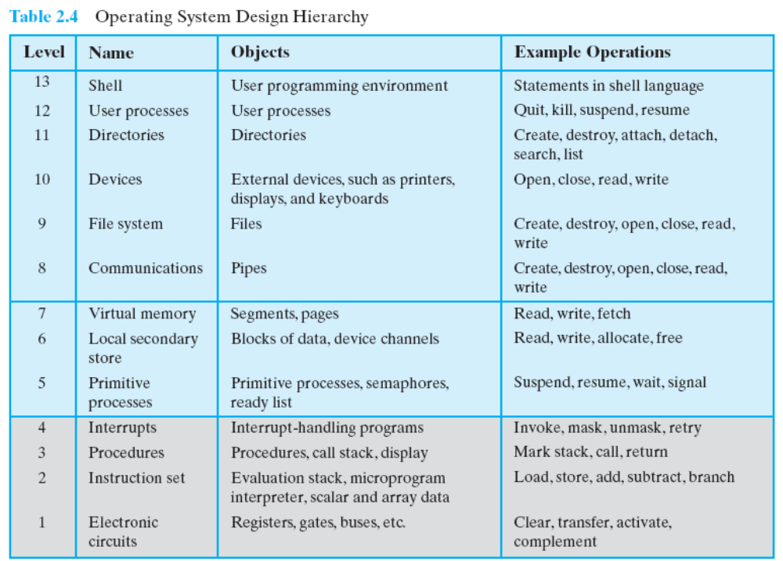
2.3.5 System Structure (4/8)

Slide 54
Agenda
2.1 Operating System Objectives and Functions
2.2 The Evolution of Operating Systems
2.3 Major Achievements
2.4 Developments Leading to Modern Operating Systems

Slide 55
2.4 Modern Operating Systems (1/8)
Background
  new developments in hardware
  new applications
  new security threats
Five features are mentioned in this chapter
  Microkernel architecture : more on chapter 4
  Multithreading : more on chapter 4
  Symmetric multiprocessing (SMP) : more on chapter 4
  Distributed operating systems : chapter 14~15: 不讲解
  Object-oriented design
Notes:
Microkernel architecture 微内核 SMP对称多处理

Slide 56
2.4 Modern Operating Systems (2/8)
Microkernel(微内核) architecture
  VS monolithic kernel(单体内核) architecture
  Assigns only a few essential functions to the kernel
    Address spaces地址空间
    Interprocess communication (IPC)进程间通信
    Basic scheduling基础调度
Notes:
地址空间，进程间通信，基础调度

Slide 57
2.4 Modern Operating Systems (3/8)
Multithreading
  Process is divided into threads that can run concurrently
    Thread
      Dispatchable unit of work
      executes sequentially and is interruptable
    Process is a collection of one or more threads and other resources
Notes:
可分派的工作单元，顺序执行，可中断

Slide 58
2.4 Modern Operating Systems (4/8)
Symmetric multiprocessing (SMP)
  There are multiple processors
  These processors share same main memory and I/O facilities
  All processors can perform the same functions
Notes:
多片对称多处理器

Slide 59
2.4 Modern Operating Systems (5/8)
Symmetric multiprocessing (SMP)
  The OS of an SMP schedules processes or threads across all of the processors.
  SMP has a number of potential advantages over uniprocessor单处理机architecture, including the following:
    Performance 性能
    Availability 可用性
    Incremental growth 可增长
    Scaling可扩展，多型号
Notes:
.增量增长:用户可以通过添加额外的处理器来增强系统的功能。
.可扩展性:生产商可以根据系统配置的处理器的数量，提供一系列不同价格和性能特征
的产品。

Slide 60
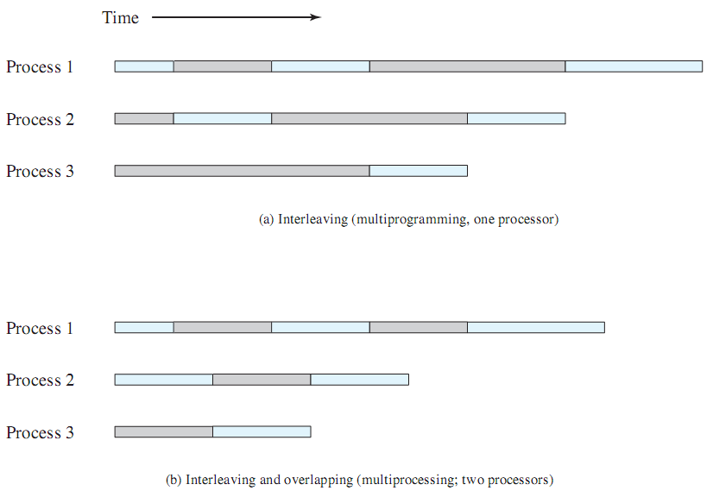
2.4 Modern Operating Systems (6/8)

Slide 61
2.4 Modern Operating Systems (7/8)
Distributed operating systems
  Provides the illusion of a single main memory space and single secondary memory space
Notes:
illusion 错觉

Slide 62
2.4 Modern Operating Systems (8/8)
Object-oriented design
  Used for adding modular extensions to a small kernel
  Enables programmers to customize an operating system without disrupting system integrity
Notes:
操作系统设计的另一个改革是使用面向对象技术。面向对象设计的原理用于给小内核增加模
块化的扩展上。在操作系统一级，基于对象的结构使程序员可以定制操作系统，而不会破坏系统
的完整性。面向对象技术还使得分布式工具和分布式操作系统的开发变得更容易。

